Slide 1
Azure Machine Learning
Microsoft Research

Slide 2
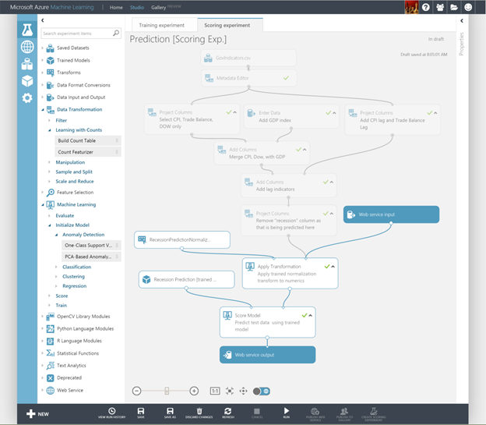
Azure Machine Learning
Cloud service for building sophisticated ML models
Includes ML Studio for composing experiments
Includes supervised algos for classification, regression, and anomaly detection
Supports R, Python, OpenCV, and more
Embodies years of research
Notes:
Machine Learning finds patterns in large volumes of data and uses those patterns to perform predictive analysis. Microsoft offers Azure Machine Learning, while Amazon offers Amazon Machine learning and Google offers the Google Prediction API. Software products such as MATLAB support traditional, non-cloud-based ML modeling.

Slide 3
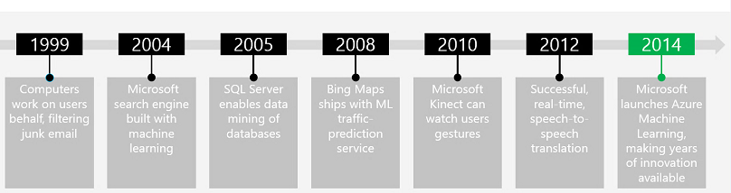


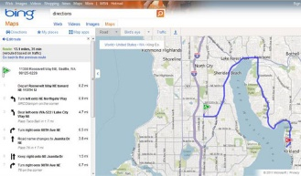
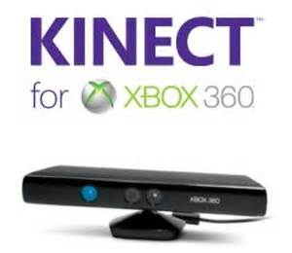
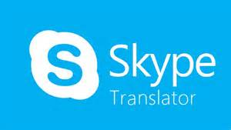


Microsoft Machine Learning History
Modified from http://pulsweb.fr/predict-wine-quality-azureml

Slide 4
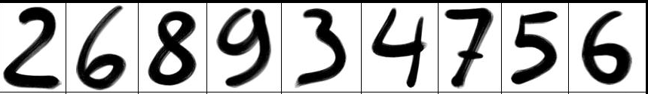

Quick Lesson on Supervised Learning
Score
Accuracy = 100%
Accuracy = 50%
2 6 8 9 3 4 7 5 6
Train -> Score
Evaluate
Score
Publish
5 1
5 6
Model

Slide 5
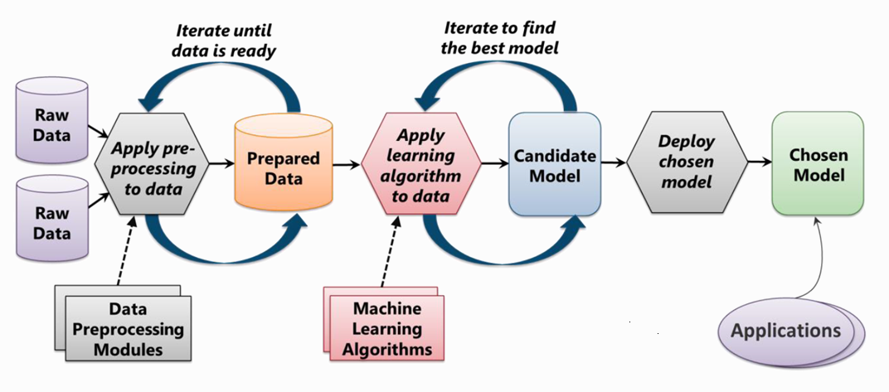
Machine Learning Process
From: Introduction to Microsoft Azure by David Chappell

Slide 6
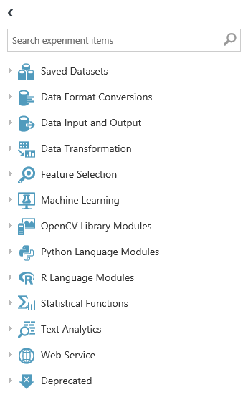
Azure ML Modules
The building blocks for workflow
Saved datasets and sample datasets
Input, output, transform, filter, split, clean, and otherwise manipulate data
Apply ML algorithms
Execute R and Python and much more
Complete list of 100+ modules at https://msdn.microsoft.com/en-US/library/azure/dn906033.aspx

Slide 7
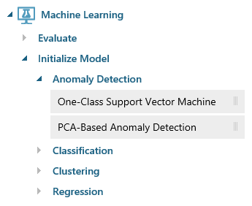
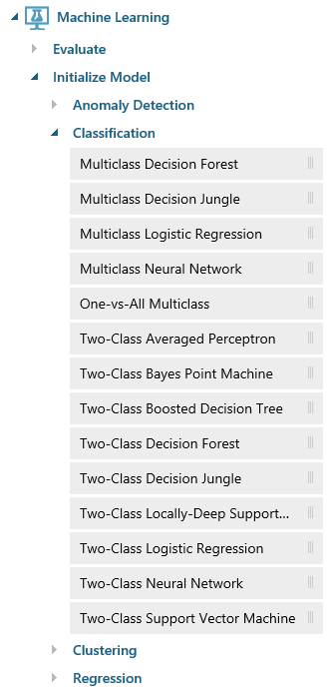
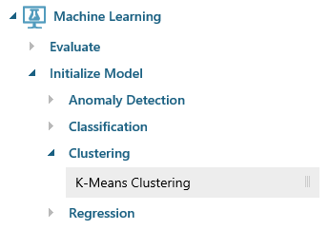
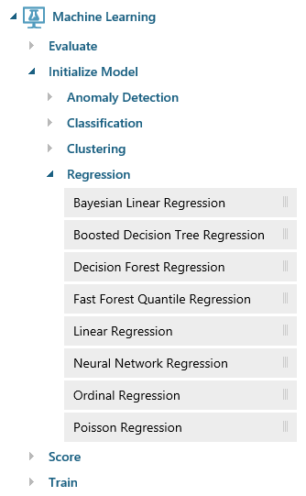
Azure ML Algorithms

Slide 8
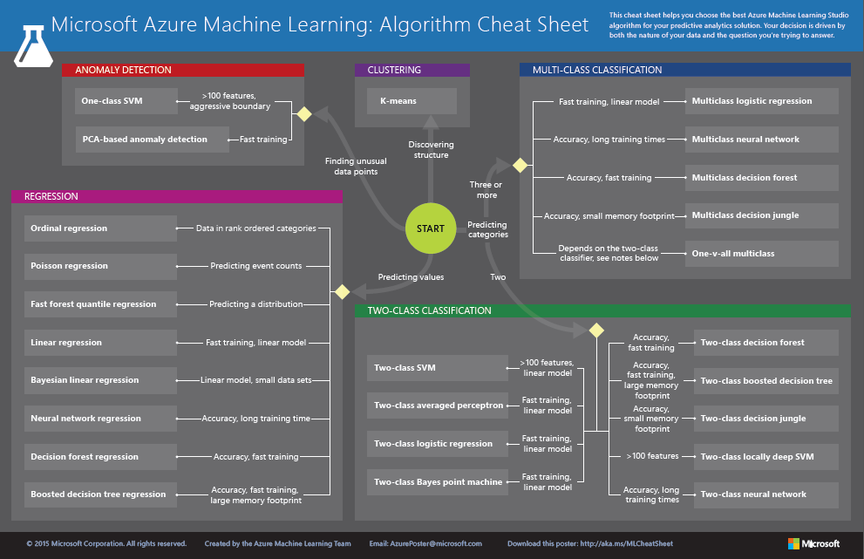
http://aka.ms/MLCheatSheet

Slide 9
Hands-On Lab
Using Azure Machine Learning
MachineLearningHOL.html

